Slide 1


DataBase Logic in Business Applications
Al.I. Cuza University of Iași
Faculty of Economics and Business Administration
Department of Accounting, Information Systems
and Statistics
Temporal Validity (Reliability) of a Database Schema
By Marin Fotache & Co.

Slide 2
Notice
All the Oracle Data Modeler diagrams in this presentation are archived and can be downloaded at:
https://github.com/marinfotache/Database-Logic-in-Business-Applications/tree/master/04_DB%20Logical%20Design__Denormalization
Please follow the instructions in `readme.md` file

Slide 3
Temporal Reliabily of a Schema
Most databases texbooks deal exclusively with schema incoporationg just current state of transactions, processes, etc.
This problem is also visible in:
OO modeling (class diagrams)
Real-world application database schemas
Facets of DB temporal reliability:
Given current DB schema, in next (say) ten years the extracted information will be reliable?
What type of data changes must be tracked?
Would be necessary (sometimes in the future) to restore the database state at a certain (sometimes far before) point in time ?

Slide 4
sales_1 Schema
Pretty close to the version of schema discussed in Databases 1 course (bachelor)
Presented in the vast mojority of databases texbooks (tables ORDERS, ITEMS, ORDER_ITEMS, ...)
Schema is severily simplified, since important information lack:
Service sales (in many cases that appear in the invoices are both products and services)
Discounts
Cancelled invoices
Refusals
Payment in advance
Penalties, etc.
On the short term, the schema appears valid (in this case, short term means until VAT percentages are changed)

Slide 5
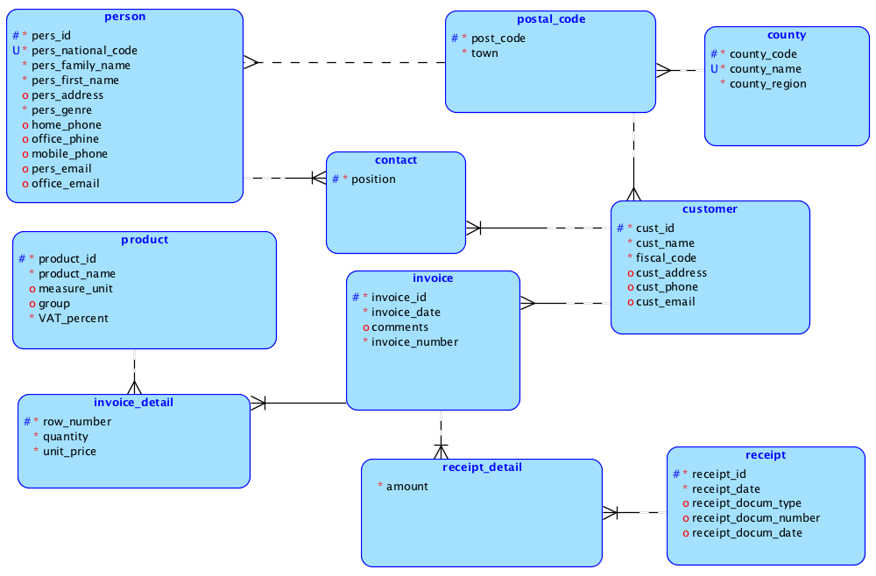
sales_1 E-R Diagram – Barker Notation

Slide 6
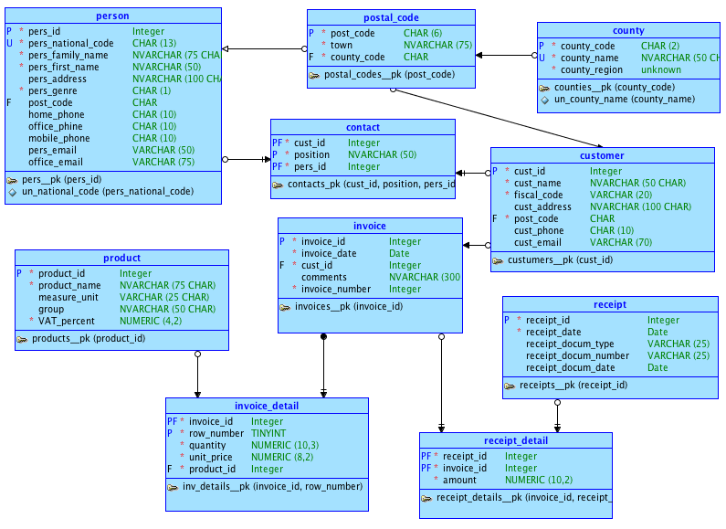
sales_1 E-R Diagram – Bachman Notation

Slide 7
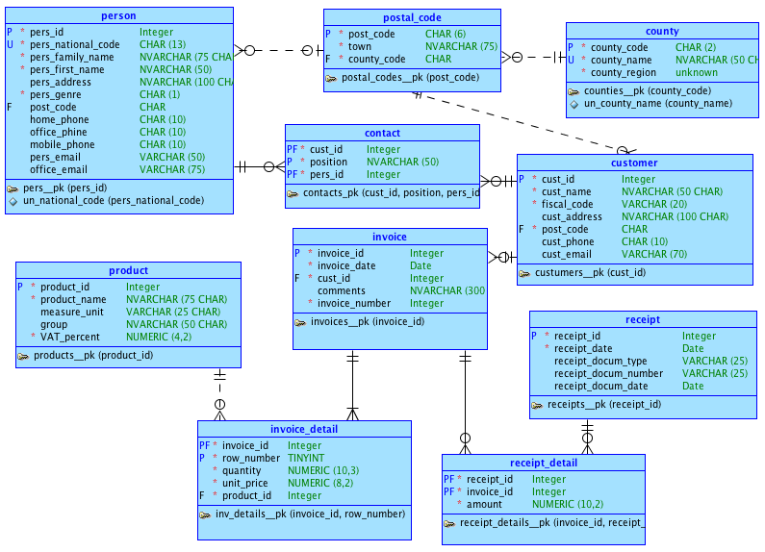
sales_1 E-R Diagram – Information Engineering Notation

Slide 8
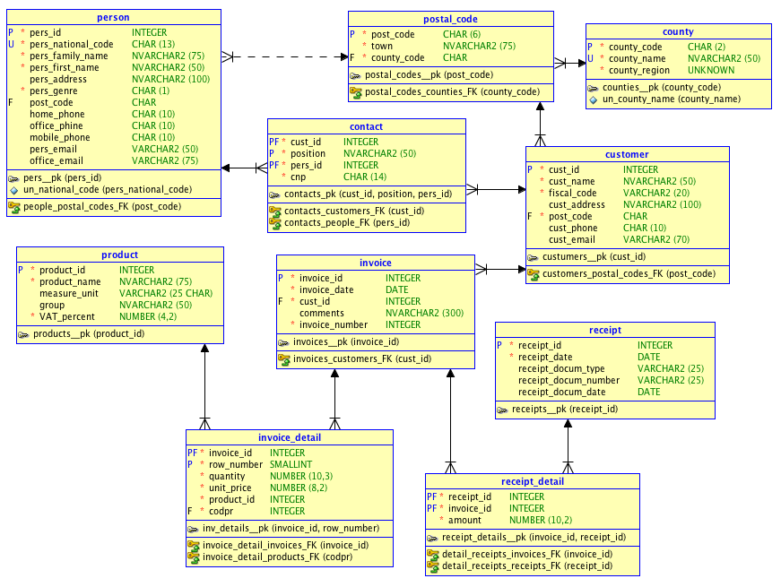
sales_1 Relational Diagram

Slide 9
sales_1 Schema is NOT Valid!
After a while (a couple of years) the VAT percents applied and products sales is changed (for some product categories or for all products)
Since invoice amount is:
SELECT invoice_id, SUM(quantity *
unit_price * (1 + VAT_percent)) AS Amount
FROM invoice_details id
INNER JOIN products p ON
id.product_id = p.product_id
GROUP BY invoice_id
for all invoices the only available product VAT percent in just the current one (the previous percents are replaced at edit time)
Consequently older invoices amount in wrong

Slide 10
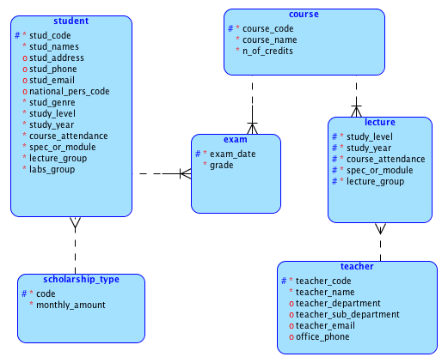
univ_info_sys_1 E-R Diagram

Slide 11
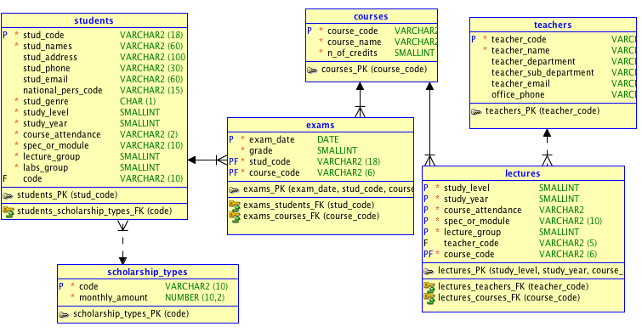
univ_info_sys_1 Relational Diagram

Slide 12
Temporal Weaknesses of univ_info_sys_1 schema
For current students it is impossible to find out the lecture and lab groups in previous semesters and years of study
We cannot know student who suspended (for a while or indefinitely) their studies
It is impossible to spot the students who changed their initially chosen bachelor or master programme or changed their course attendance (from regular courses to distance courses or viceversa).
Students enrolled in two programmes (simulateneously) cannot be tracked with this version of database schema

Slide 13
Temporal Weaknesses of univ_info_sys_1 schema (cont.)
The topics taught by a faculty member (professor) in her/his carreer are impossible to be known
Also we cannot find all the faculty members that have been taught a certain course/topic
Sometimes the number of credits shared by courses changed over time; we have access only to the current number
Current status of a students is incertain: did he pass all of his exams, including the elective courses; can he enroll in the succeeding study year of his program ?, etc.

Slide 14
A Better (Temporal) Schema - catering
For details, see the DBLBA page on the FEAA portal
A much stable database (from temporal point of view), because:
Schema was better designed (detailed)
The nature of the problem was more transactional
Nevertheless, the is no shortage of temporal issues, since a good deal of information are unavailable:
Position history of all contacts
Contract changes
Product price history
Catalog content along the years
Former employees
Position history of our employees
Data abouy equipments and vehicles no longer in use
Changes in recipes (ingredients used to prepare some products)

Slide 15
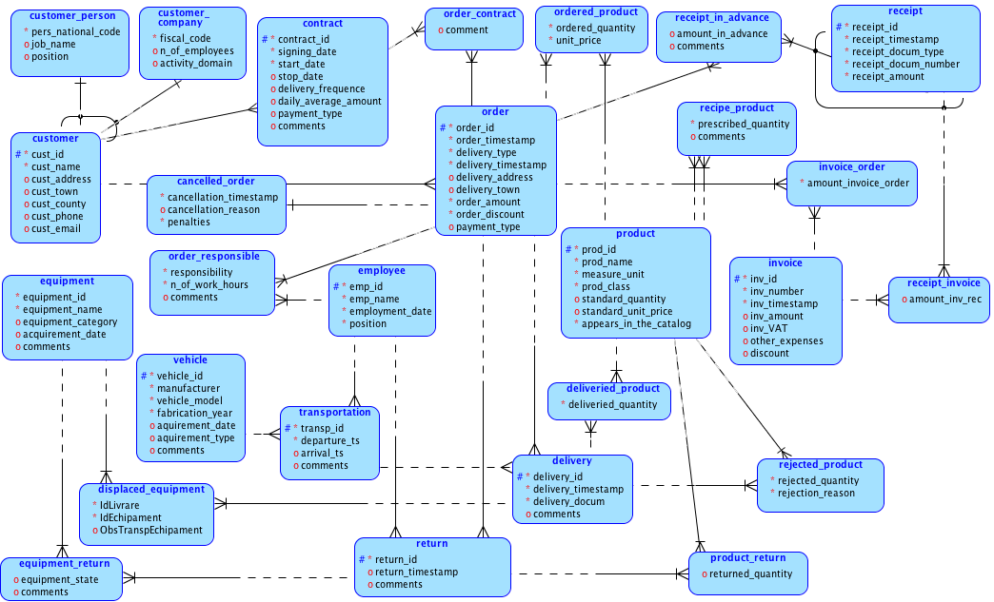
catering E-R Diagram

Slide 16
Two Basic Solutions to Temporal Problems in Database Design (see also next slides)
New attributes:
sales_1 schema:
INVOICE_DETAILS.row_VAT
CONTACTS.from and CONTACTS.to
univ_Info_Sys_1 schema:
LECTURES.academic_year and LECTURES.semester
EXAMS.coordinating_teacher
New tables (probably the most frequent)
sales_1 schema:
PRODUCTS_VAT_HISTORY
CONTACTS_HISTORY
univ_Info_Sys_1 schema:
STUDENT_ACADEMIC_TRACK
SCHOLARSHIP_HISTORY
CURRICULA

Slide 17
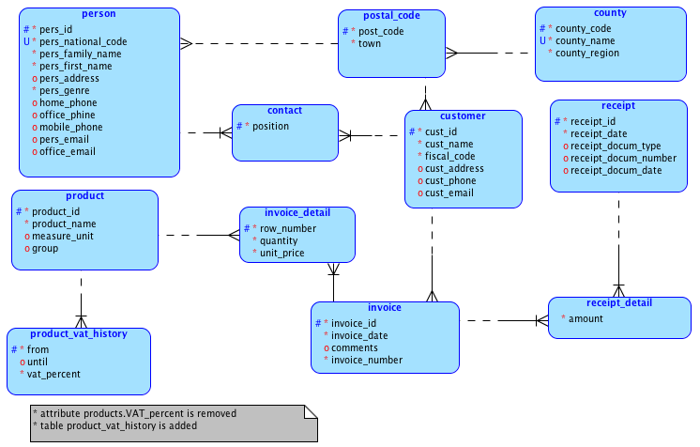
sales1__solution_1 E-R Diagram

Slide 18
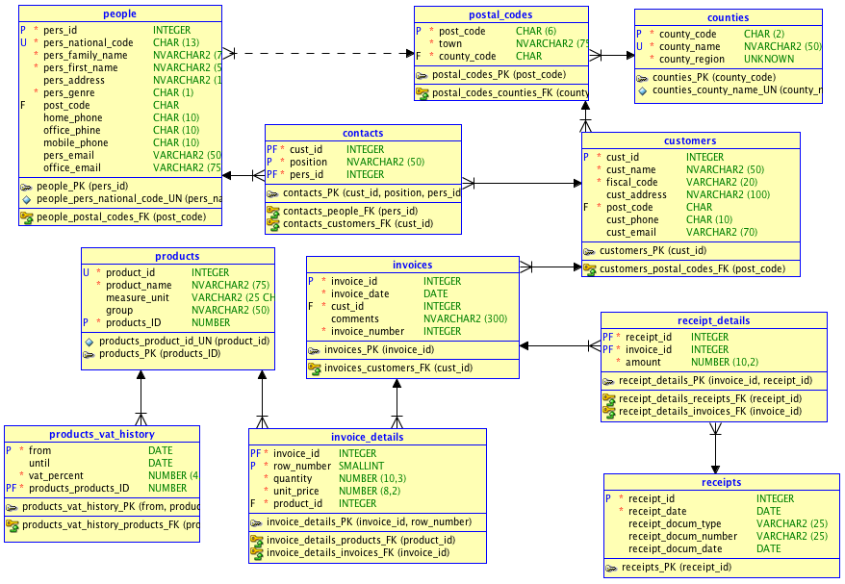
sales1__solution_1 Relational Diagram

Slide 19
sales_1__solution's Main Drawback
Getting invoice amount is more tedious (and time consuming, since it requires an additionaj join) :
SELECT i.invoice_id, SUM(quantity *
unit_price * (1 + VAT_percent)) AS Amount
FROM invoices i
INNER JOIN invoice_details id ON
i.invoice_id = id.invoice_id
INNER JOIN products_vat_history pvh ON
id.product_id = pvh.product_id AND
i.invoice_date BETWEEN pvh.from AND
COALESCE(pvh.until, CURRENT_DATE)
GROUP BY i.invoice_id
for all invoices the only available product VAT percent in just the current one (the previous percents are replaced at edit time)
Consequently older invoices amount in wrong

Slide 20
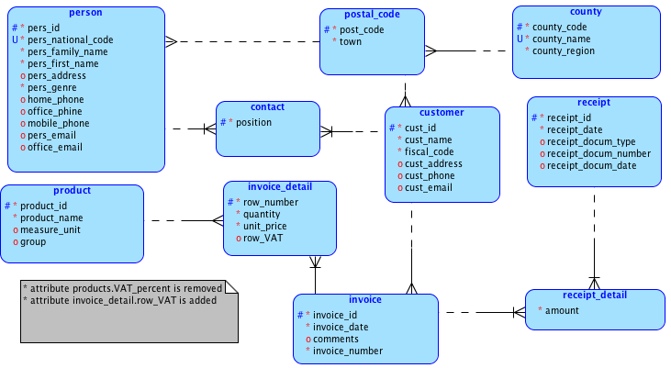
sales1__solution_2 E-R Diagram

Slide 21
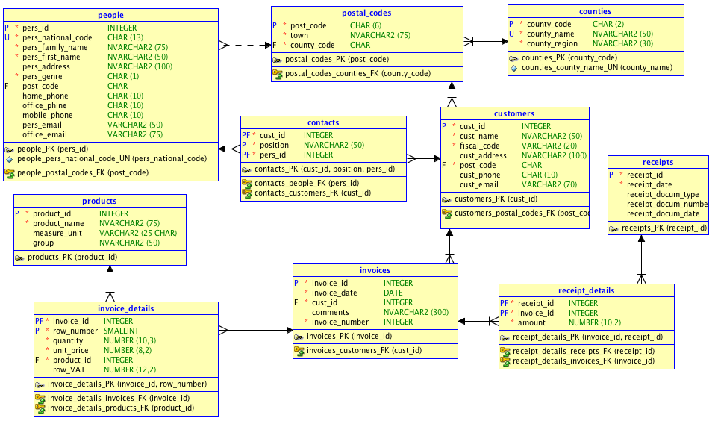
sales1__solution_2 Relational Diagram

Slide 22
sales_1__solution_2 Strengths and Weaknesses
Strengths
Each invoice's amount is computed without errors, no matter how old the invoice is
Query for computing invoice amount is fairly simple:
SELECT i.invoice_id, SUM(quantity *
unit_price * + row_VAT) AS Amount
FROM invoices i
INNER JOIN invoice_details id ON
i.invoice_id = id.invoice_id
GROUP BY i.invoice_id
No need for a join with table products
Weaknesses
Product current VAT percent is not stored (not known)
Product current VAT must be typed "manually" each time a product is sold

Slide 23
Other solutions for sales Database Schema
See next presentation about De- and Post-Normalization

Slide 24
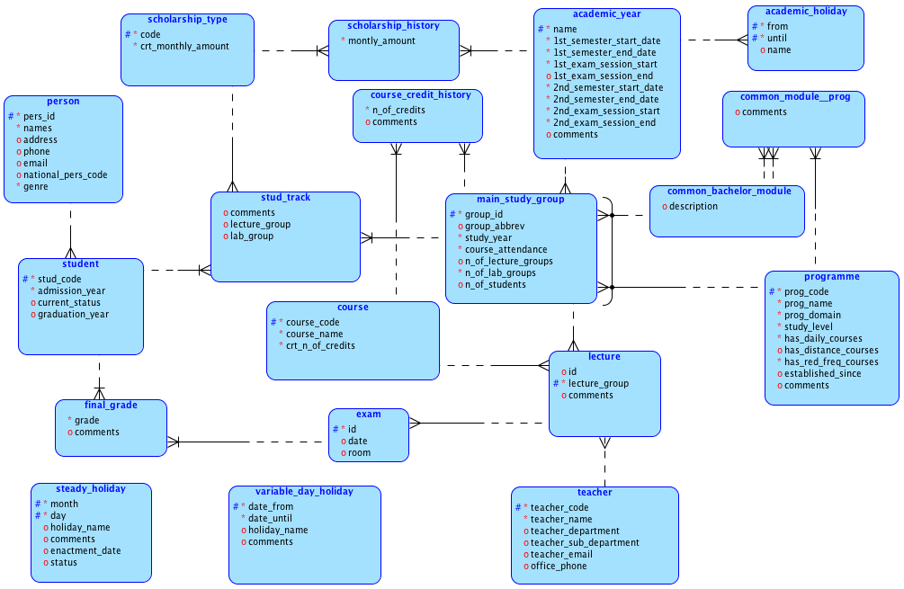
univ_info_sys_2 E-R Diagram

Slide 25
univ_info_sys_2 vs. univ_info_sys_1 Improvements
Academic scheduler available for all academic years
History of:
Number of credits for each course on every academic year
Student scholarship amounts
Academic holidays
Tracks of variable and "steady" (that fall each day on every year – e.g. Christmas) national and religious holidays
Common bachelor study groups are separated from programme's main groups of study
We now which study groups count for what programme
Each study group is linked to an academic year
Lecture groups are recorded as associated to study groups

Slide 26
univ_info_sys_2 vs. univ_info_sys_1 Improvements (cont.)
For each faculty member all the taught courses are tracked
Also for each course we know every lecture group and who taught it in corresponding academic year
Exams are recorded on each lecture group, not on every students
Assessment is separated from exams (refers to a student)
There is a separation between general data about students (name, genre, address) and basic information about his enrollments; consequently, it is possible to find out which bachelor, master of ph.d. programmes the student was enrolled in
Morever, it is possible all the student track, whith some limitations
Student cannot enroll two programmes simultaneously
Student cannot change his programmes within an academic year
Scholarship is granted yearly

Slide 27
univ_info_sys_2 Main Weaknesses
Students cannot enroll simultaneously into two programmes (not a quite often situation, but possible)
It is not possible if students "graduated" (passed the majority of the courses) a study year and can be enrolled in the next study year
We cannot find the "lagged" courses (courses postponed the next academic years, even the student advanced in the next study year)
We cannot find out which courses are compulsory and which electives
No track of elective courses packages
No track of non-final assessment
Semestrial or yearly grade averages are impossible to compute

Slide 28
Main Resource on Database Schema Temporal Validity (in Romanian)
https://github.com/marinfotache/Database-Logic-in-Business-Applications/blob/master/Proiectarea%20bazelor%20de%20date.%20Normalizare%20si%20post-normalizare%202005/PBD2005_Cap10_Temporalitate.pdf

